Slide 1

FMI experience at ZF – Progress in MAP „System Structure and Parameterization"

Slide 2
Agenda
1.
Introduction ZF
2.
Use-cases for FMI in ZF
3.
Applications in ZF
4.
FMI becomes ZF-Standard
5.
Motivation / Planning MAP System Structure and Parameterization
6.
Defined Use-cases
7.
The SSD approach
8.
First prototypes

Slide 3
Agenda
1.
Introduction ZF
2.
Use-cases for FMI in ZF
3.
Applications in ZF
4.
FMI becomes ZF-Standard
5.
Motivation / Planning MAP System Structure and Parameterization
6.
Defined Use-cases
7.
The SSD approach
8.
First prototypes

Slide 4
Corporate Structure ZF Friedrichshafen AG Shareholders: 93.8 % Zeppelin Foundation and 6.2 % DR. JÜRGEN AND IRMGARD ULDERUP FOUNDATION
Board of Management
Dr. Stefan Sommer – Chief Executive Officer / R&D / Market / ZF Services
Dr. Konstantin Sauer – Finance, IT, M&A | Jürgen Holeksa – Human Resources / Governance / Region Asia Pacific | Michael Hankel – Production / Car Powertrain Tech. / Car Chassis Tech. / Electronic Systems | Wilhelm Rehm – Materials Management / Industrial Technology | Rolf Lutz – Quality / Commercial Vehicle Technology / Region South America | Dr. Franz Kleiner – Active & Passive Safety Technology / Region North America
Braking Systems
Steering Systems
Commercial Steering Systems
Occupant Safety Systems
Electronics
Body Control Systems
Engineered Fasteners & Components
Parts & Service
Automatic Transmissions
Manual Transmissions / Dual Clutch Transmissions
Axle Drives
Powertrain Modules
Electric Drive Technology
Die Casting Technology
Chassis Systems
Chassis Components
Suspension Technology
Truck & Van Driveline Technology
Axle & Transmission Systems for Buses & Coaches
CV Chassis Modules
CV Damper Technology
CV Powertrain Modules
Off-Highway Systems
Test Systems
Special Driveline Tech.
Marine Propulsion Systems
Aviation Technology
Wind Power Technology
Active & Passive Safety Technology
Dr. Franz Kleiner
Division Car Powertrain Technology
Bernd Stockmann
Division Car Chassis Technology
Uwe Coßmann
Division Commercial Vehicle Technology
Fredrik Staedtler
Division Industrial Technology
Hermann Beck
Electronic Systems
ZF Services

Slide 5

THE POWER OF² Key figures
The new ZF Group – An Overview
 | ZF (incl. TRW) | ZF | TRW
Sales | > € 30 billion | € 18.4 billion | € 13 billion
Employees | 134,000 | 71,000 | 63,000
R&D expenditure | € 1.6 billion | € 891 million | € 720 million

Slide 6
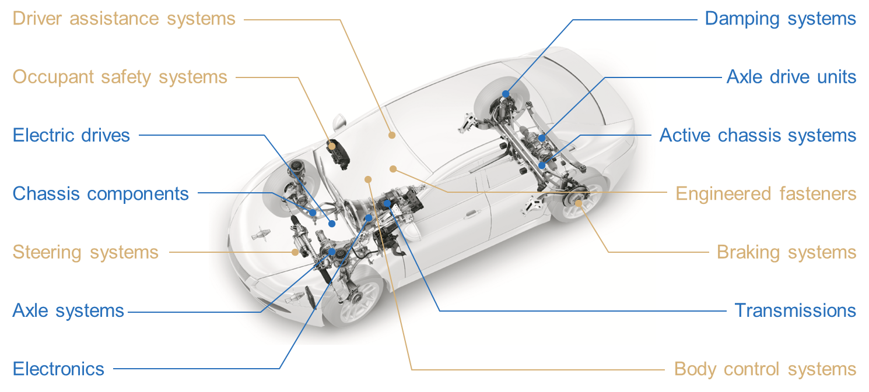
THE POWER OF² Product Portfolio
ZF
TRW
Notes:
Our portfolio is very balanced in terms of industry coverage, customer outreach and global footprint.
We combine ZF’s driveline and chassis technologies, incl. e-mobility solutions and electronics, with TRW’s safety, steering, braking, and autonomous driving technologies.
We use the opportunity to leverage TRW’s car-focused products to further expand ZF’s diversified portfolio across multiple industries.
We bring together ZF’s premium with TRW’s volume customer access.
We integrate ZF’s strength in Europe with TRW’s strength in North America, and develop a joint approach to reach a comparable position in Asian growth markets.
Complemented by a comprehensive and strong aftermarket, this gives us broad market coverage to build on.

Slide 7
Agenda
1.
Introduction ZF
2.
Use-cases for FMI in ZF
3.
Applications in ZF
4.
FMI becomes ZF-Standard
5.
Motivation / Planning MAP System Structure and Parameterization
6.
Defined Use-cases
7.
The SSD approach
8.
First prototypes

Slide 8
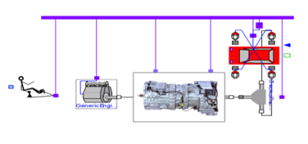
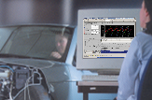


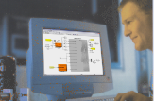


How to test ECU Software with Modelica-Models
System Requirements
Dymola
Validation/Application
production software
Vehicle
Software Requirements
Oasis
FMI
Functional-/Failuretest
production software
HiL Teststand
Software specification
SW integration and test
-
Simulink
Software Design
SW component test
Verification
Design
SoftCar
Code
FMI is standardizing model exchange !

Slide 9


Generating FMUs only once for several Targets
Integration Tool
FMI for Co-Simulation
FMU
Authoring Tool
Model
Dymola
Dymola
Solver
Oasis
FMI for Model Exchange
FMU
Simulink
Model
Simulink

Slide 10
Modularization on cycle-simulations
ICE
Bremse
Drive
Getriebe
-
E
BM
Batterie
Leistungs
-
elektronik
DC/DC

Slide 11
Agenda
1.
Introduction ZF
2.
Use-cases for FMI in ZF
3.
Applications in ZF
4.
FMI becomes ZF-Standard
5.
Motivation / Planning MAP System Structure and Parameterization
6.
Defined Use-cases
7.
The SSD approach
8.
First prototypes

Slide 12
Actual applications
Software model RangeExtender for PKW
Modeling with Modelica
Import as co-simulation-FMU in Softcar
Oscillation model 8HP for SIL
Software development for shifting 3-2
Rebuild of DRESP-models in Modelica
Import as co-simulation-FMU in Softcar
Damper model for racing car application
Detailed model in Modelica
Export as co-simulation-FMU for external customers

Slide 13
Agenda
1.
Introduction ZF
2.
Use-cases for FMI in ZF
3.
Applications in ZF
4.
FMI becomes ZF-Standard
5.
Motivation / Planning MAP System Structure and Parameterization
6.
Defined Use-cases
7.
The SSD approach
8.
First prototypes

Slide 14
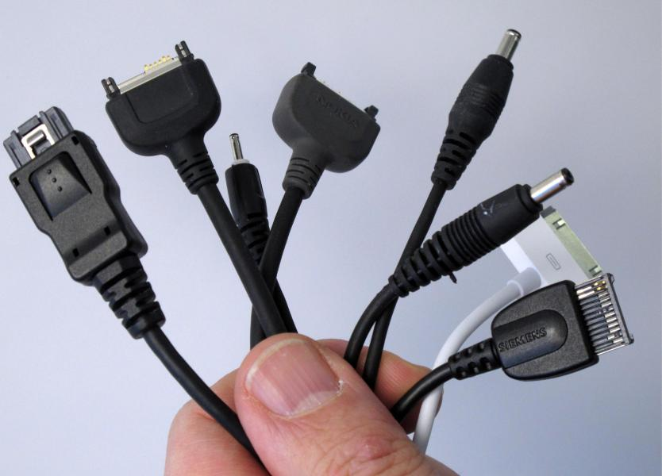
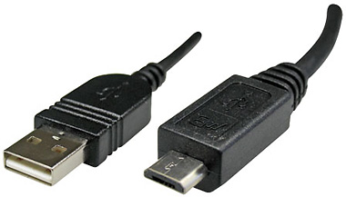
Making FMI being a ZF-Standard
Proceeding
Validation of FMI (2013-2014)
Including FMI functionality into in house tools (Softcar, OASIS)
Evaluation of FMI (2015-2016)
High level of experience in central research with very good results
Finding other teams that want to evaluate FMI
Developing a Directive for FMI as ZF Standard (2016)

Slide 15
Agenda
1.
Introduction ZF
2.
Use-cases for FMI in ZF
3.
Applications in ZF
4.
FMI becomes ZF-Standard
5.
Motivation / Planning MAP System Structure and Parameterization
6.
Defined Use-cases
7.
The SSD approach
8.
First prototypes

Slide 16
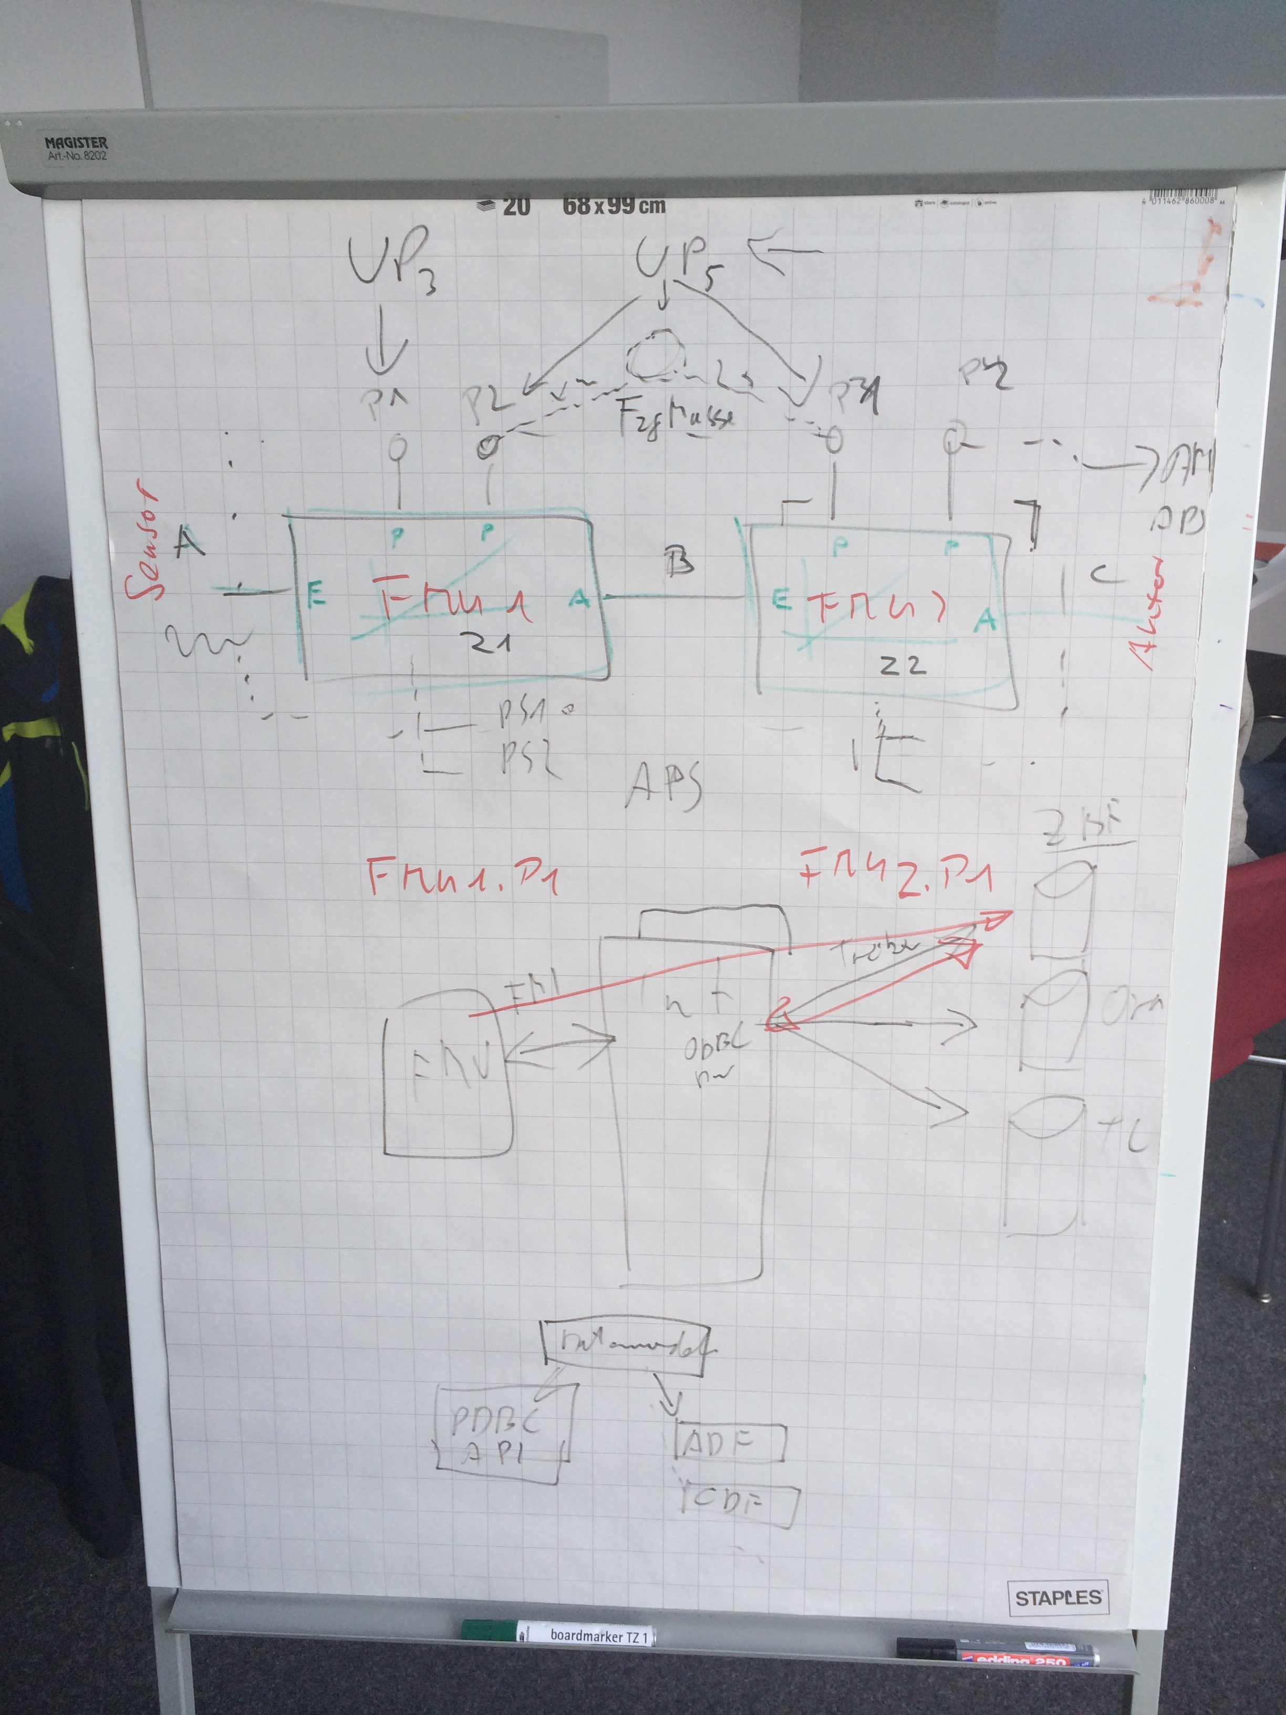
Motivation for initiating MAP System Structure and Parameterization (SSP)
Origin of SSP
Workshop with BMW, Bosch, ZF 02/2014 – Collecting “missing” features around FMI standard
Presentation “Proposal for a standardized parameterization of FMUs / Models” and “FMI Mapping” on Modelica-Conference (2014, Lund)
Initiating the Modelica-Association Project “System Structure and Parameterization”
Purposes of MAP-SSP
Define a standardized format for the connection structure for a network of components.
Define a standardized way to store and apply parameters to these components.
The developed standard / APIs should be usable in all stages of development process (architecture definition, integration, simulation, test in MiL, SiL, HiL).
This work in this project shall be coordinated with other standards and organizations (FMI, ASAM, OMG).

Slide 17


Planned Goals for MAP SSP in 2015
Working schedule
Draft definition of data model for system structures exists (as XML schema).
Representative reference system structure is defined. ( )
FMUs are exported from different generators.
At least two running prototypes (with co-simulation) exist for exchanging application packages in a round trip use-case based on the draft definition.
Draft definition of data model for parameter sets exists.

Slide 18
Agenda
1.
Introduction ZF
2.
Use-cases for FMI in ZF
3.
Applications in ZF
4.
FMI becomes ZF-Standard
5.
Motivation / Planning MAP System Structure and Parameterization
6.
Defined Use-cases
7.
The SSD approach
8.
First prototypes

Slide 19
Defined Use-Cases
UC 01 Exchange of one FMU / Model with multiple different Parameter Sets
UC-03 Exchange of Parameter Sets with Restricted Visibility / Changeability of Parameters
UC-04 Encryption and Authentication of Parameter Sets
UC-05 Describing parameter sets for system architecture
UC-06 Handling parameter sets independently from FMUs/Models
UC-07 Use of one parameter set for parameterization of several FMUs
UC-08 Meta information for parameters
UC-09 Describing a system structure
UC-10 Handling different parameter set formats
UC-11 Handling parameters within an authoring tool
UC-12 Providing parameters sets for simulation
UC-13 Standard parameter handling plugin
UC-14 System architectures with signal-adoption-layers
UC-15 Parameter Data Model

Slide 20
Exchange of one FMU / Model with multiple different Parameter Sets
FMU1
Authoring Tool
Integration Tool
Param-Set1
Std Plugin
SSD

Slide 21
Handling different parameter set formats
SSD
FMU1
FMU2
Authoring Tool
Param-Set1
Param-Set2
Param-Set2
SSD
Std Plugin
Plugin A
SSP
Parameter Tool
2

Slide 22
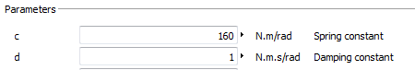
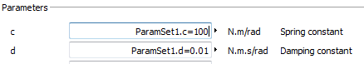
Handling parameters within an authoring tool
SSD
FMU1
FMU2
Authoring Tool
Param-Set1
Param-Set2
Param-Set2
ParamSet1.c=100
ParamSet1.d=0.01
ParamSet2.alfa=0.3
ParamSet2.beta=5.2
SSD
Std Plugin
Plugin A
SSP
Parameter Tool

Slide 23
Describing parameter sets for system architecture
SSD
FMU1
FMU2
Authoring Tool
Integration Tool
Sys Param-Set
SSP
Param-Set1
Param-Set2
ParamSet1.c := SysParamSet.c
ParamSet2.alfa := 0.5*SysParamSet.alfa
SSD
Std Plugin
Parameter Tool

Slide 24
Describing a system structure
Complete SSP
FMU1
FMU2
Authoring Tool
Integration Tool
SSD
Sys Param-Set
SSP
Param-Set1
Param-Set2
ParamSet1.c := SysParamSet.c
ParamSet2.alfa := 0.5*SysParamSet.alfa
SSD
Std Plugin
SSP

Slide 25
System architectures with signal-adoption-layers
Complete SSP
FMU1.u1 := pi/30*u1
FMU1
FMU2
FMU1.u2 := u2
FMU2.u := 0.01*FMU1.y
y1 := 100*FMU2.y1
Authoring Tool
y2 := FMU2.y3
Integration Tool
SSD
Sys Param-Set
SSP
Param-Set1
Param-Set2
ParamSet1.c := SysParamSet.c
ParamSet2.alfa := 0.5*SysParamSet.alfa
SSP
Std Plugin

Slide 26
Agenda
1.
Introduction ZF
2.
Use-cases for FMI in ZF
3.
Applications in ZF
4.
FMI becomes ZF-Standard
5.
Motivation / Planning MAP System Structure and Parameterization
6.
Defined Use-cases
7.
The SSD approach
8.
First prototypes

Slide 27
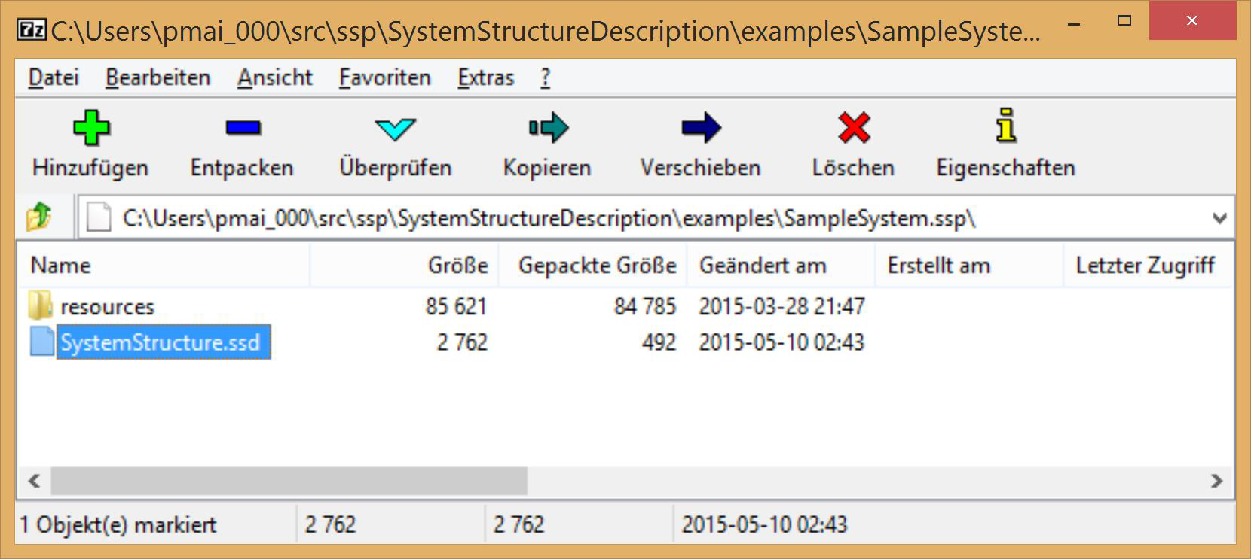
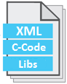
Design Goals and Basic Package
Design Goals
Minimize additional semantics, rely on FMI as far as possible
Fit into FMI world (use FMI-like design choices where reasonable)
System Structure Package (SSP)
SSP is a „ZIP“ container with standardized content (System Structure Package)
‘SystemStructure.ssd’ is main system structure description file
Referenced FMUs, SSPs, etc. packaged in resources directory
SSD
FMU
SSP
*.SSP

Slide 28
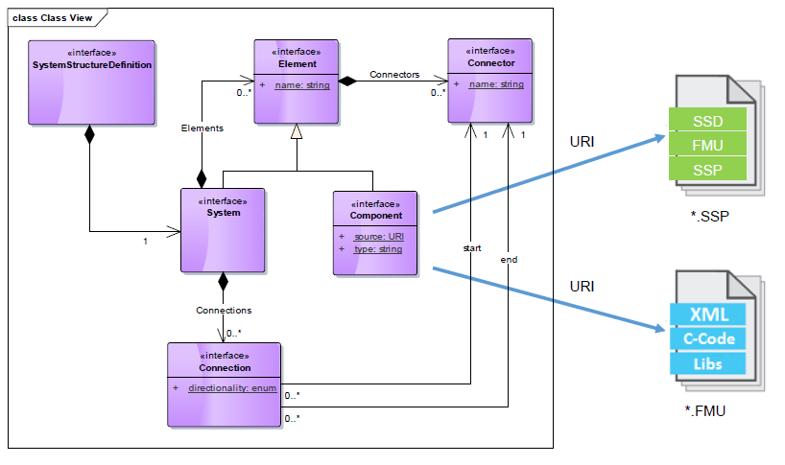
Basic Data Model (UML)
https://svn.modelica.org/projects/ssp/trunk/SystemStructureDescription/SystemStructureDescription.xsd

Slide 29
Agenda
1.
Introduction ZF
2.
Use-cases for FMI in ZF
3.
Applications in ZF
4.
FMI becomes ZF-Standard
5.
Motivation / Planning MAP System Structure and Parameterization
6.
Defined Use-cases
7.
The SSD approach
8.
First prototypes

Slide 30
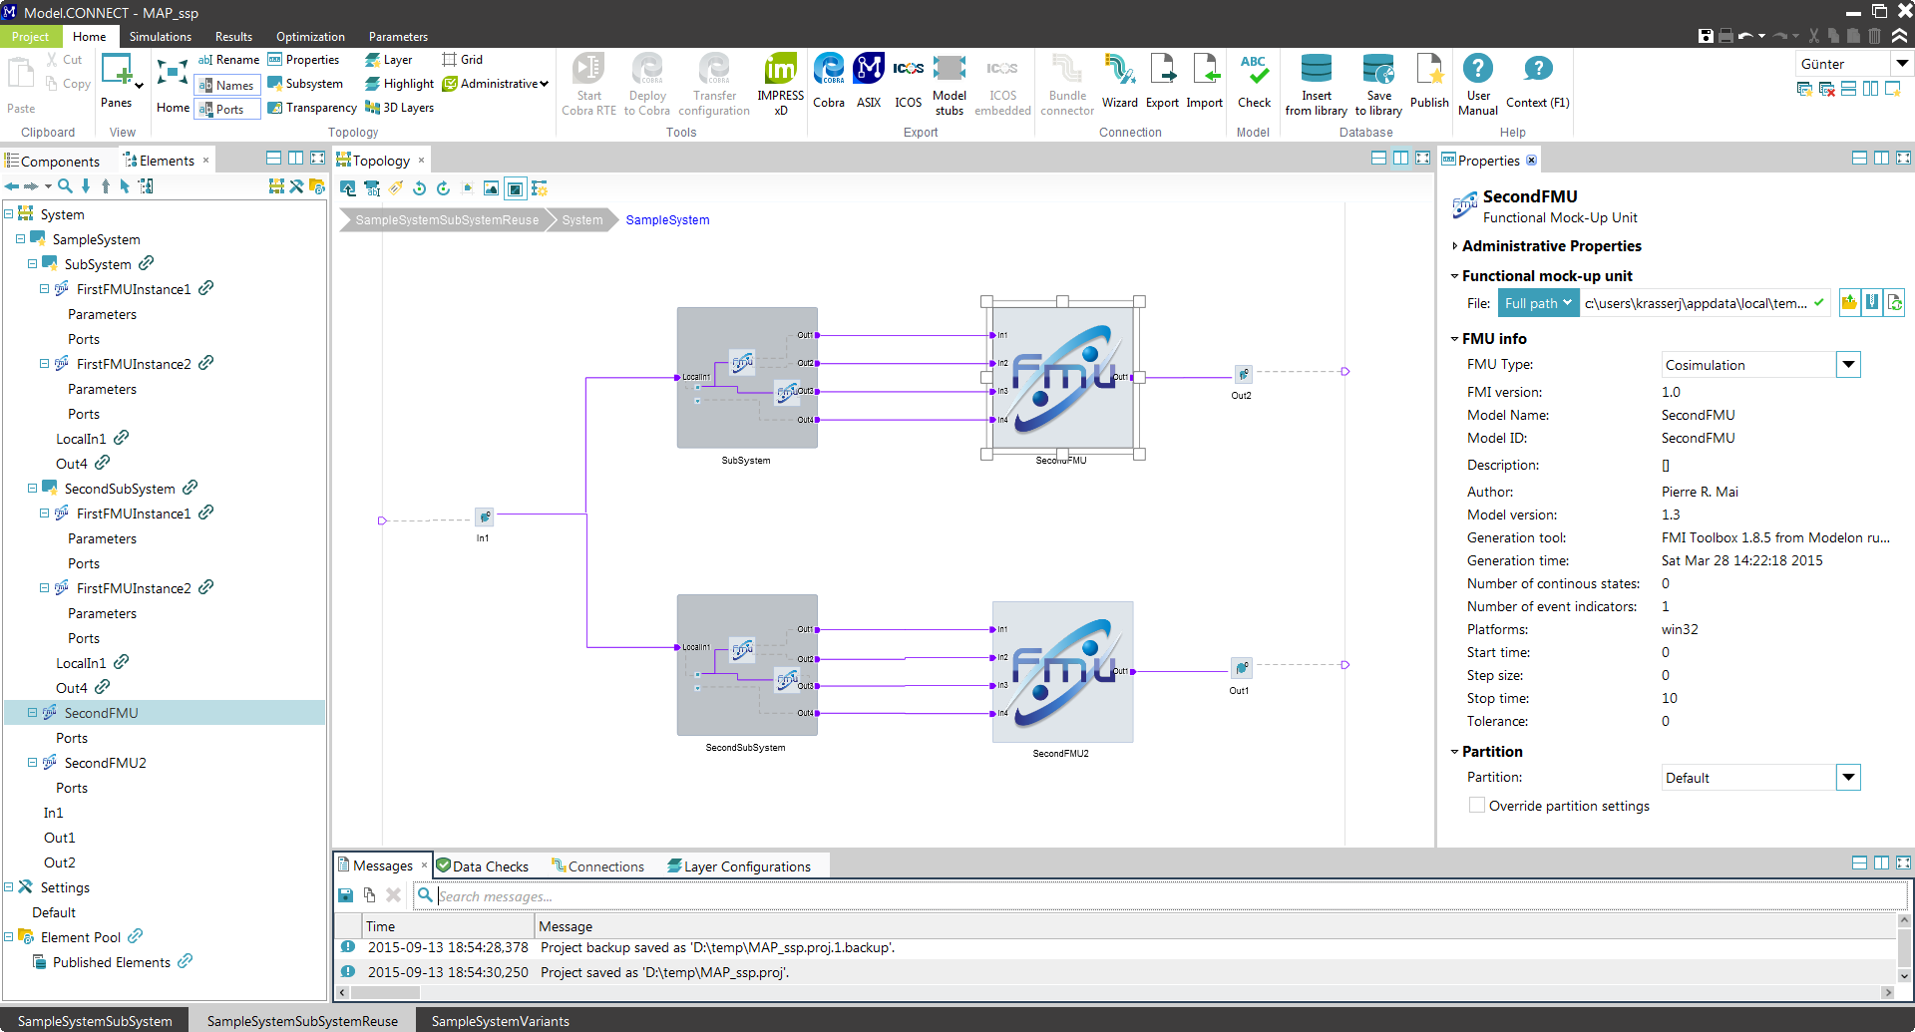

Prototype from AVL – in Model.CONNECT™
Model.CONNECTTM is a platform to set up and execute system simulation models which are composed of subsystem and component models from multiple model authoring environments.

Slide 31
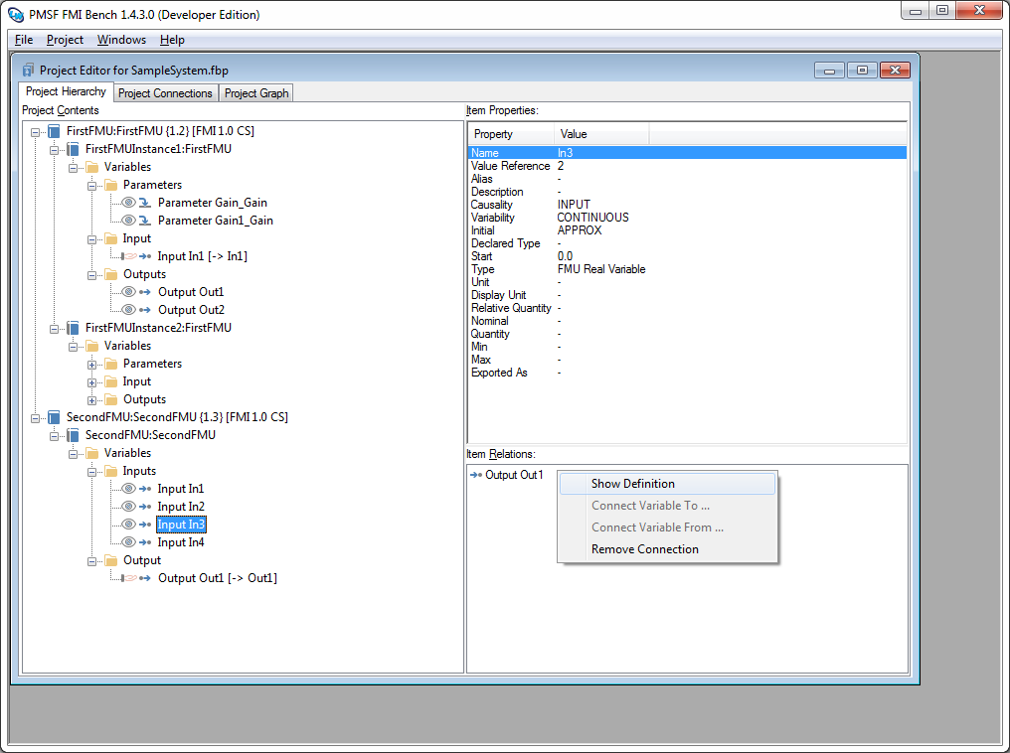

Prototype PMSF FMI Bench: Workbench for FMUs
FMU Inspector
FMU Pre-Integration
FMU Debugging
FMU Customization

Slide 32

Thank you

